Slide 1

Fixing issues in a Note Taking Application
Kesana Srinivasarao

Slide 2
About Me:
I am an independent, strong-motivated and self-made person who is eager to learn new technologies. My Educational background includes a master’s degree from IIT Guwahati, providing me with strong foundation in analytical and problem solving skills.
I discovered my interest for data science during my master’s studies, where I involved into collecting and analyzing data for my thesis. I realized that I enjoyed solving problems, especially those involving math. This led me to pursue a career in data science, as it was the thing I enjoy and at the same time rewarding.
I did not have any prior experience but had little understanding from my master's thesis. All the knowledge gained from the online sources and now with this Internship.
LinkedIn Profile: My profile

Slide 3
Project description: Developing a Note Taking Application
A team of enthusiastic data scientists started developing a Note Taking application using Python, Flask, and HTML. However, their limited experience in backend development has resulted in challenges, preventing the application from functioning properly. They seek assistance in fixing the broken code and ensuring the application works seamlessly.

Slide 4
Objective:
The objective is to refactor the existing code of the Note Taking Application and ensure its proper functioning.
Steps to be followed:
Identify the existing issues and bugs with in the code.
Analyse the code to understand the root causes.
Update the code to address the identified bugs and improve the code quality.
Test the application to verify the effectiveness of the changes made.
Ensure that the Note Taking Application works seamlessly, allowed users to add notes without encountering any errors.

Slide 5
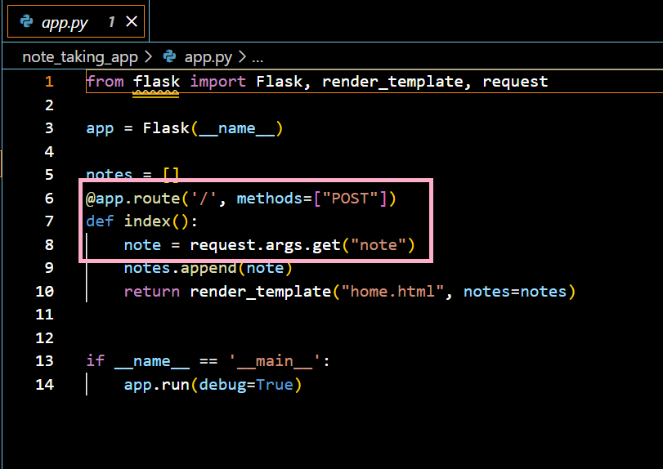
Initial code before fixing the Bug:
Python Flask code before bug fixing

Slide 6
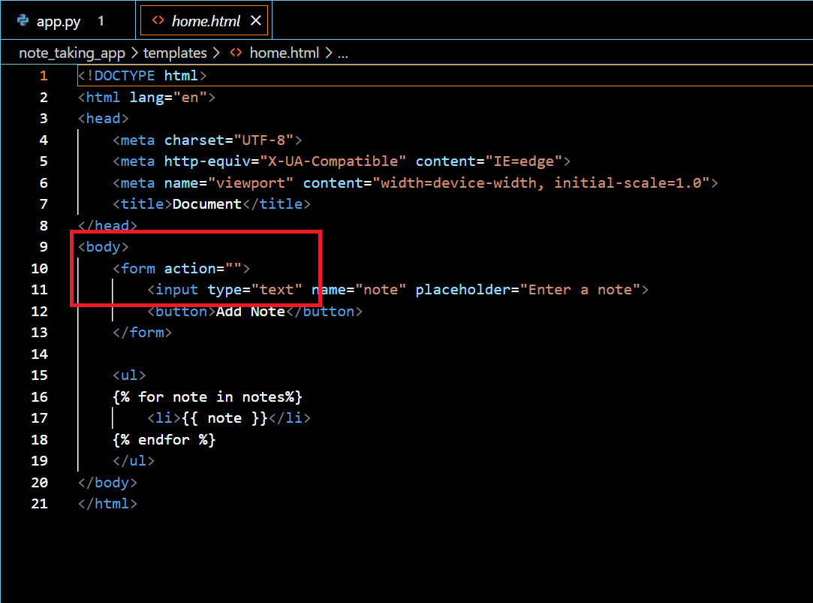
HTML code before bug fixing

Slide 7
Identifying the problem with code:
When submitting notes via “add a note” form, the flask application is encountering an issue with handling POST request. Specially, while the GET request work as expected, POST requests are not being handled correctly, resulting in a method error.
In Figure 1, the highlighted section indicates that the POST request method is being used, but there seems to be an issue with retrieving the note correctly. The syntax for getting the note appears to be incorrect.
Similarly, in Figure 2, the body section of the HTML code shows that the form action is not linked to a proper URL for the intended action, and the request method is also not specified. Both of these aspects need to be corrected to ensure the application functions properly.

Slide 8
Resolving the issue:
I resolved the POST request issue by updating the code to handle both GET and POST requests by using if statement. Additionally, I fixed the HTML code by linking it to the proper URL and specifying the request method.
The following images shows the fixed code:

Slide 9
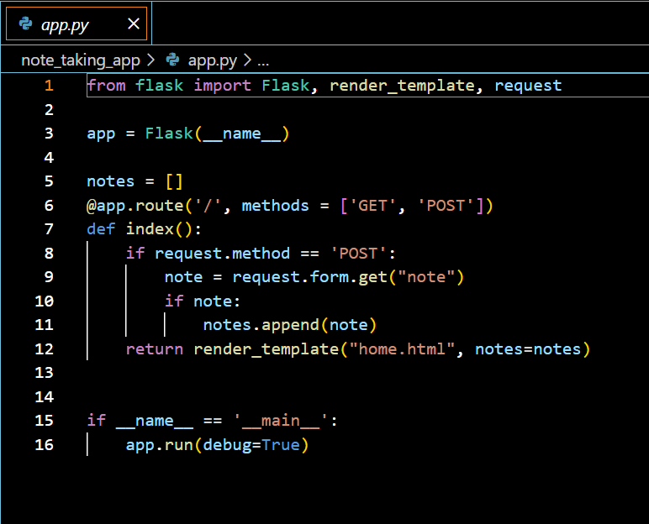
Python Flask code After bug fixing

Slide 10
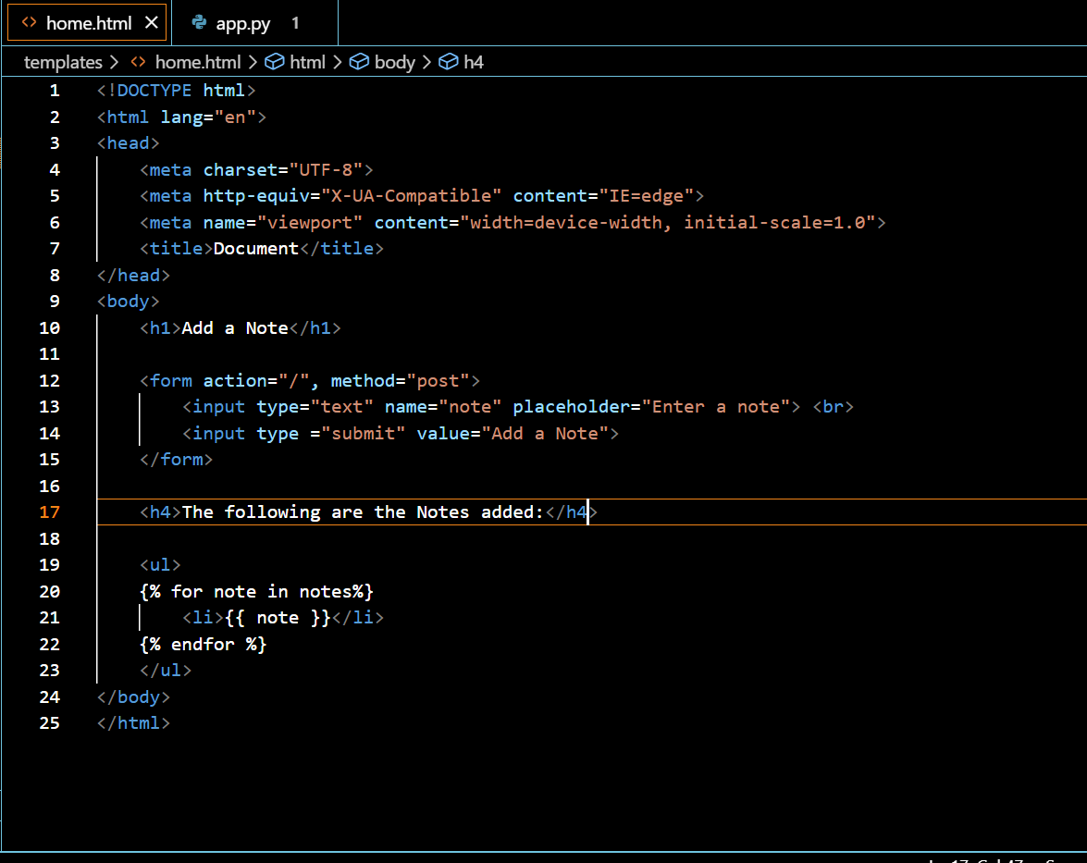
HTML code After bug fixing

Slide 11
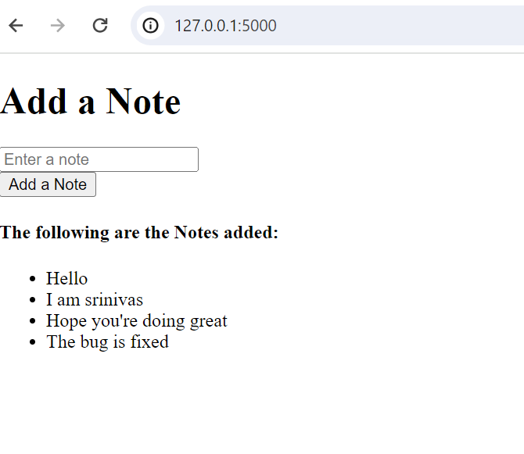
The final outcome of the Note Taking Application looks like this:

Slide 12
Conclusion:
By addressing the issues with POST request handling in the code and fixing the HTML route problem, now the Note Taking Application is fully functional. Users can seamlessly add notes without encountering any errors.

Slide 13

THANK YOU

